Slide 1

MKT 591: Marketing Analytics,
Linear Regression Application

Slide 2
Brief Review from Previous Class
Measurement: Discrete, Continuous
Cross Tab
Correlations
Statistical Testing: Null Hypothesis, P-value, Interpretations

Slide 3
MKT 591: Course Roadmap
Review of Quant Market Research
Prediction / Regression
Forecasting
Features & Dimensions
Market Segmentation
Simple Linear Regression
Demand Forecasting
Customer Classification
Factor Analysis
Segmentation Basic
Measurement Scales
Categorical Variables
BASS Diffusion Model
Discriminant Analysis
MDS
Advanced Model-based Segmentation
Discrete Analysis (CrossTab)
Extracting Features by Text Analytics
Multiple Regression
Bayesian Classifier
Spatial Segmentation
Continuous Analysis (Correlation)
Issues in Regression
Tree Models
Intro Deep Learning
Logistic Regression
Intro Bayesian Statistics

Slide 4
Bivariate Linear Regression

Slide 5
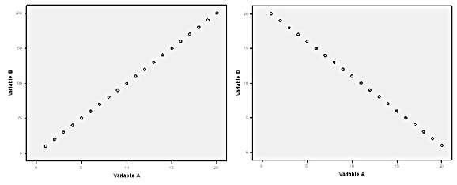
One Hypothetical Example: what if we observed perfect positive correlation or negative correlation in population?
Assuming the perfect positive correlation between Sales and Promotion, how can you predict Sales?
Assuming the perfect negative correlation between Sales and Price, how can you predict Sales?

Slide 6
Example – Sales Data
SALES
PRICE
If we increase our price to $3, what will happen to out sales (best guess)?

Slide 7
Example – Sales Data
What we observe from data
SALES
PRICE
PROMOTION
ADVERTISING
COUPON
DISPLAY
••••••
Many other possible factors which can affect sales
(or not available in data).

Slide 8
SALES
PRICE
PROMOTION
Considering all other factors as a random variable.
ADVERTISING
COUPON
DISPLAY
SALES = f ( PRICE, Some other factors )
Two Assumptions of Regression Model
Linear Relationship Between SALES and PRICE
Other factors follow N( )
Notes:
Linear

Slide 9
SALES = f ( PRICE, Other factors )
Assumptions of Regression Model
Focusing on Linear Relationship Between SALES and PRICE (Our main interest variable)
Other factors follow N( )
i-th market or unit
Dependent Variable
Independent Variable
“coefficients”
“error”

Slide 10
Regression Model
This model specifies the population-level relationship among sales, price, and other factors. → our best guess using the observed data.
To use this model, we should know ____ and ____.
Using sample data, we make inferences on and .

Slide 11
SALES
SALES i = b₀ + b₁ * PRICE i + e i
e i (error)
b₀+ b₁ * PRICE i
PRICE
Determine b₀ and b₁ by minimizing the sum of squared errors
Notes:
b0 and b1 are coefficients from samples.

Slide 12
Correlation and Regression
Correlation is a measure of the degree of association between two continuous variables.
Regression analysis is the process of constructing a mathematical model that can be used to predict one variable by another variable. – Managers want to do a scientific guess for prediction (e.g., Sales).
−1 ≤ r_{xy} ≤ 1

Slide 13
Simple Regression Analysis
Bivariate (two variables) linear regression – the most elementary regression model
1 dependent variable, the variable to be predicted, usually called Y.
1 independent variable, the predictor or explanatory variable, usually called X.
Goal: to predict Y as a linear function of X:
Ŷ = b₀ + b₁X
You specify X and Y, then estimate b_{o} and b₁
Marketing examples — How can predict product sales using product price? What is the relationship between household income and the entertainment expenditures?
Notes:
5

Slide 14
Bivariate Regression Equation
Intercept represents the expected mean value of Y when X=0.
Other names of Independent variables:
Covariates, Predictors, Explaining variables, etc.

Slide 15
Example: Airline Cost
A few of the many variables that can potentially contribute to the cost of flying a commercial airliner are: type of plane, distance, number of passengers, amount of luggage/freight, weather conditions, direction of destination, and perhaps even pilot skill.
Question: Can the number of passengers predict the cost of flying? Main interest or available data is ‘The number of Passengers’.
Simple Expectation: More passengers can result in more weight and more baggage, which could result in increased fuel consumption and other costs.
Let’s see the following data to develop a simple regression.
Notes:
6

Slide 16
A Simple Example: Airline Cost Data
n = 12
Notes:
6

Slide 17
Scatter Plot of Airline Cost Data
Sample Correlation: r_{XY} = .948 (p-value < 0.05)
Notes:
7

Slide 18
Ŷ = b₀ + b₁X₁
Estimated mathematical model (i.e., Bivariate Linear Regression) to predict Y using predictor X.
Notes:
14

Slide 19
Obtaining b₀ and b₁ estimates
e_{i} = Y_{i} – b₀ – b₁X₁ = residuals or error
Want to estimate b₀ and b₁ to minimize the total prediction errors across the sample (Least Squares Estimation)
Notes:
14

Slide 20
Model Assumptions
Linear Model: Y_{i} = b₀ + b₁X₁ + e_{i}
Error: e_{i} ~ N(0, σ²)
σ² constant over all observations
Random samples taken across independent observations → error terms are independent
Assume X and Y are continuous scales in this case (We will see the generalized discrete cases later)
Notes:
6
If the data is very different from the assumption, the model might not work well… Good model has great flexibility and can be generalized.
For example, time series data is not independent observations – we need to capture (or control) time dependency with parameters.

Slide 21
Model Estimation (by Least Squares)
Minimize these squared errors
Take partial derivatives of Z above with respect to b₀ and b₁, set equal to 0, and solve to get:
Estimating parameters
(b1 and b0)
See “OLS Derivation” file for more details in the BlackBoard
Notes:
10
Let’s find parameters! One example… This is a simple case. Model estimation is not easy sometimes. So, we will not focus on the model estimation in this course. Let software do that for us!!!
In least square method, b0 and b1 are from samples. For population level beta, we need distribution assumption (Normal distribution for t-tests). – let stat software do this work…

Slide 22
Solving for b₁ and b₀ of the Regression: Airline Cost Example (Part 1)
Notes:
12
Sun===

Slide 23
Solving for b₁ and b₀ of the Regression Line: Airline Cost Example (Part 2)
Statistics software takes care of this, but it is worth to go through this one time.
Notes:
13

Slide 24
Graph of Regression Line for the Airline Cost Example
Notes:
14

Slide 25
Residual Analysis: Testing the Assumptions hold, Airline Cost Example
Notes:
15

Slide 26
Plot of Residuals for the Airline Cost Example
Notes:
16

Slide 27
Diagnostics: Suppose You See A Nonlinear Residual Plot
0
X
Deviation from the original model assumption:
Errors are not independent → errors still include certain pattern… ☹
Notes:
18
Are we missing a certain pattern in data? There are dependency in error term but the model doesn’t capture it.

Slide 28
Non-constant Error Variance
0
X
0
X
Deviation from the original model assumption
Notes:
19
The model doesn’t capture certain pattern.

Slide 29
Plots of Non-independent Error Terms
0
X
0
X
Deviation from the original model assumption
Endogeneity issue… Error term is somehow related to variable X (Problematic Issue in academic research, e.g., econometrics)
Notes:
20
Missing variable… If there are endogeneity (e.g., missing variable), estimated coefficients can be biased.

Slide 30
Healthy Residual Plot (Ideal)! ☺
0
X
We want to see a random scatterplot for residuals
Notes:
21

Slide 31
Now, we have a estimated regression results. Luckily, in most cases, software estimates the regression for us and it will report estimation results. Now, interpretation is our responsibility!

Slide 32
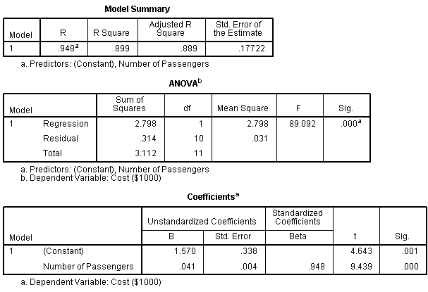
Airline Cost: Summary Output for Regression
Three useful points we want to Interpret with Regression Analysis.
1. How good our model is? (fitting)
2. Overall model is significant?
3. How about each coefficients?

Slide 33

In-Class Practice for R
(Let me do this in R…)
Amusement Park Satisfaction Data (see Text Book p160)
An amusement park collected survey from 500 customers and want to understand the relationship between various factors and customer satisfaction.
The data includes:
Weekend (discrete, binary): Yes or No
Number of child (continuous or discrete)
Distance (continuous): distance from home
Rides (continuous) # 100-point scale for satisfaction
Games (continuous) # 100-point scale for satisfaction
Wait (continuous) # 100-point scale for satisfaction
Clean (continuous) # 100-point scale for satisfaction
Overall (continuous) # 100-point scale for overall satisfaction (DV)

Slide 34
Results Summary with R
What does all this mean? :
These are what we want to learn.
3. How about each coefficients?
2. Overall model is significant?
1. How good our model is?
Notes:
P value significant: slope and intercept != 0
R square low: low correlation between independent and dependent

Slide 35
1. The R-Square Statistic
R-square statistic: “Explaining power of the regression model”
Explains what percent of the total variation in Data you can explain by the regression model
0 ≤ R² ≤ 1
34.3% of the variability
of data can be explained by the regression model.
More intuitive example will be in next slide…
Notes:
25

Slide 36
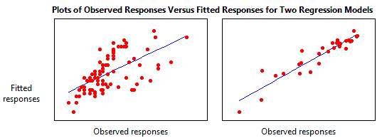
(Intuitive Example) Which one has larger R-square value?
R-square = ?
R-square = ?
Larger R square: more percentage of data can be explained by the regression model (Larger predictive power).
Notes:
.38 vs. .874
R square tell the explanation power of regression line, data point sparse from the regression line; large proportion of data point are regarded as error.
P-value tell the how beta is different zero (beta !=0)
Parameter p value: how regression line is different from a horizontal line
R square: how many dots can be explained by regression line.

Slide 37
2. Testing the Overall Model
H₀: all slopes = 0
H₁: all slopes ≠ 0

Slide 38

3. Hypothesis Test: Amusement Park Example
H₀: β₁ = 0
H₁: β₁ ≠ 0
Null hypothesis reflects flat horizontal line which indicates no relationship between X and Y.
How about coefficients in our example?
Notes:
27

Slide 39
Predicted Satisfaction: Amusement Park Example
To obtain prediction
Translation: If the satisfaction of rides is 90, the predicted score of overall satisfaction can be 58.
Thus, we can use this equation to make predictions for customer satisfaction.
Notes:
29

Slide 40
In-Class R Exercise (5 minutes) (with amusement park data)
Use games or wait each as an independent variable for the simple (bivariate) linear regression
Q1: Find R-Square and make an interpretation of the R-Square.
Q2: Please check the overall model significance by using F-statistics (see p-value).
Q3: Please find the estimated coefficient value and check the significance of the coefficient.
Q4: What are the predicted satisfaction score with games=70 and wait=80?

Slide 41
Multiple Linear Regression
Multiple regression includes more than one independent variables (IVs).
It sounds simple but including multiple IVs bring a number of issues.
It is not simply adding more than one IVs… (We will discuss them later.)

Slide 42
Example – Sales Data
Available in data or modelers are focusing…
PRICE
SALES
ADVERTISING
PROMOTION
COUPON
DISPLAY
••••••
Many other possible factors which can affect sales

Slide 43
Multiple Regression
Not simply more than one but there are many issues… we will discuss them later
Multiple Regression Model – generalize simple regression to include more than one independent variables
Y = β₀ + β₁X₁ + β₂X₂ + β₃X₃ + . . . + β_{k}X_{k}+ ε
Y = the value of the one dependent (response) variable
β₀ = the regression constant
β₁ = the partial regression coefficient of independent variable 1
β₂ = the partial regression coefficient of independent variable 2
β_{k} = the partial regression coefficient of independent variable k
k = the number of independent variables
ε = the error of prediction
Notes:
4

Slide 44
Response Plane for Two-Predictors Multiple Regression Model
Y
Vertical Intercept
error
Y₁
Response Plane
X₂
X₁

Slide 45
Real Estate Example
A real estate study was conducted in a small Louisiana city to determine what variables, if any, are related to the market price of a home. Several variables were explored, including the number of bedrooms, the number of bathrooms, the age of the house, the number of square feet of living space, the total number of square feet of space, and the number of garages. Suppose the researcher wants to develop a regression model to predict the market price of a home (DV) by two variables, “total number of square feet in the house” and “age of the house” from a random sample of n=23 home sales.
Notes:
9

Slide 46
Real Estate Data
Notes:
9

Slide 47
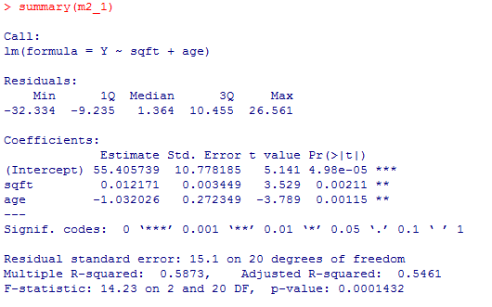
Regression Output for the Real Estate Example
Q) What is null hypothesis for the overall model significance? Is this model significant overall? How can you make your conclusion?
Notes:
11

Slide 48
Predicting the Price of Home
Ŷ = 55.406 + .012X₁ – 1.032X₂
IF X₁ = 2500 square feet and X₂ = 12 years,
Ŷ = 55.406 + .012(2500) – 1.032(12)
= 93.658 Thousand Dollars
Notes:
12

Slide 49
Evaluating the Multiple Regression Model
F-test
Testing the Overall Model
H₀: β₁ = β₂ = β₃ = ∙ ∙ ∙ = β_{k} = 0
H_{a}: At least one of the regression coefficients is ≠ 0
H₀: β₁ = 0 | H₀: β₃ = 0
H_{a}: β₁ ≠ 0 | H_{a}: β₃ ≠ 0
 | ⋮
H₀: β₂ = 0 | H₀: β_{k} = 0
H_{a}: β₂ ≠ 0 | H_{a}: β_{k} ≠ 0
Significance Tests for Individual Regression Coefficients
t-tests
Notes:
13
F-test does not include the significance of intercept term. It tests the all slopes… It is testing linear relationships between IVs and DV.

Slide 50
Testing the Overall Model for the Real Estate Example
H₀: β₁ = β₂ = 0
H_{a}: At least one of the regression coefficients is ≠ 0
Notes:
14

Slide 51
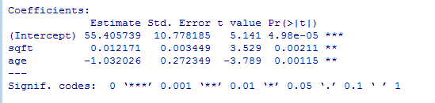
Significance Test of the Regression Coefficients for the Real Estate Example
H₀: β₀ = 0
H_{a}: β₀ ≠ 0
H₀: β₁ = 0
H_{a}: β₁ ≠ 0
H₀: β₂ = 0
H_{a}: β₂ ≠ 0
Notes:
15

Slide 52
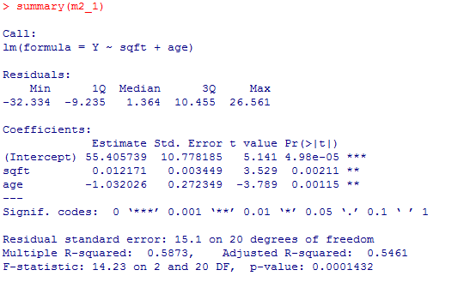
Coefficient of Multiple Determination (R²)
R² = The percent of variation in Y explained by the independent variables;
Limitation of R² : When adding independent variables, it keep increasing (overfitting issue – too much fitting for this sample data)
Notes:
21
More independent variables will only increase R square
To avoid overfit, use adjusted R-square

Slide 53
Adjusted R²
adj. R² : Want to adjust for the sample size and the number of independent variables in the equation, as well as their “overlap.”
NOTE: adj. R² ≤ R²
Notes:
21

Slide 54
In-class practice 1: Amusement Park
DV: Overall Satisfaction
IV: Rides, Games, Wait, Clean
Is the overall model significant?
What are the relationship between Overall Satisfaction and four predictors?
Which factor(s) you will focus on to improve overall satisfaction in future? In other words, what is your priority for marketing resource allocation?

Slide 55
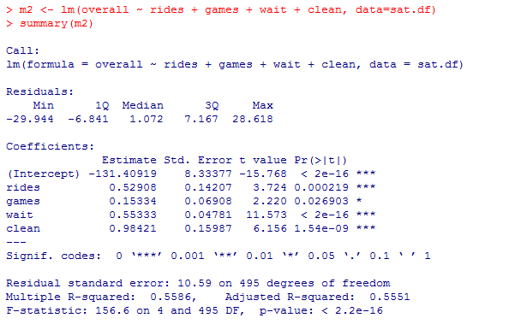
Demonstration Problem: Regression Output

Slide 56
Resolving Overfitting Issue
Model Selection Criteria other than simple R²: Penalizing too many parameters – penalizing too much fitting for the sample data.
Regularization – variable selection such as Ridge regression or Lasso (We will learn this next class)

Slide 57
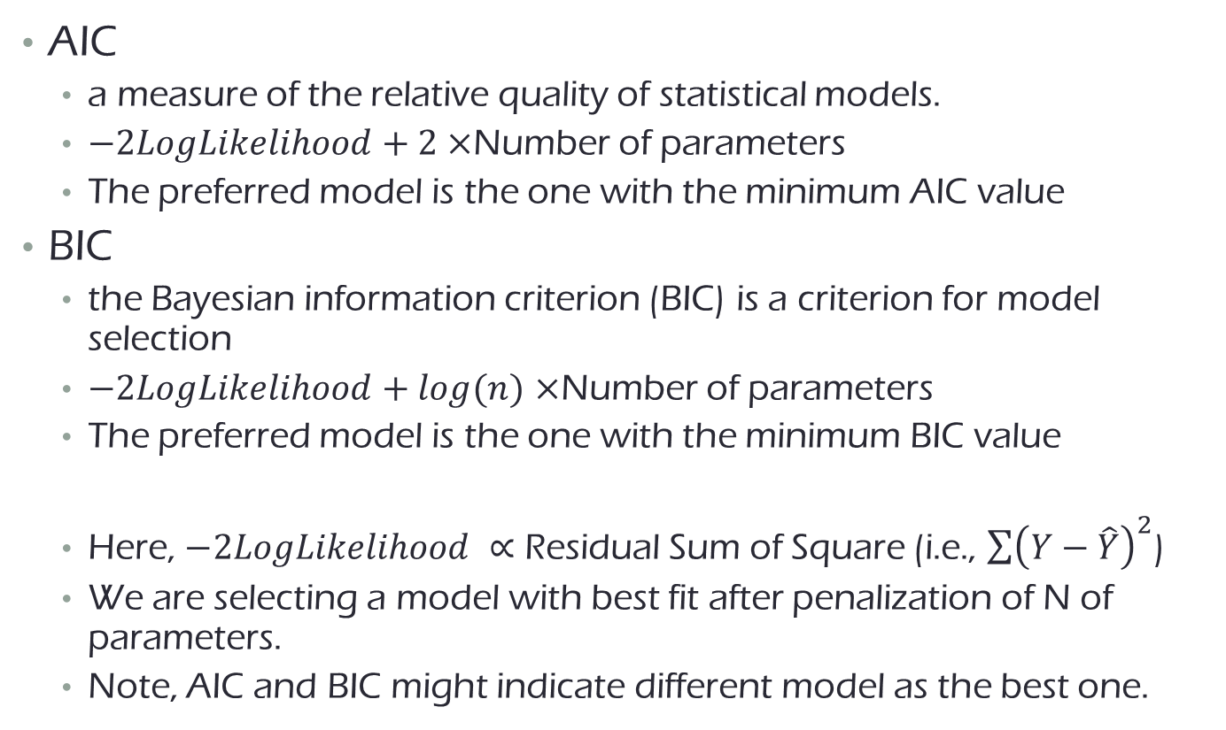
Model Selection Information Criteria: Selecting independent variable(s) in regression
AIC
a measure of the relative quality of statistical models.
$−2LogLikelihood+2×$Number of parameters
The preferred model is the one with the minimum AIC value
BIC
the Bayesian information criterion (BIC) is a criterion for model selection
$−2LogLikelihood+log(n)$ $×$Number of parameters
The preferred model is the one with the minimum BIC value
Here, $−2LogLikelihood ∝$ Residual Sum of Square (i.e., $\sum{{\left(Y−\hat{Y}\right)}^{2}}$)
We are selecting a model with best fit after penalization of N of parameters.
Note, AIC and BIC might indicate different model as the best one.
Penalization term for overfitting
Penalization term for overfitting
Notes:
logLik(m1) – usually negative values
AIC in R: -2*logLik(m1)+2*13 – usually, positive values; we choose a model with minimum AIC [a model with better fit after penalization for many parameters)
Here 13 includes all coefficients + variance of Y.
If conflict between AIC & BIC, people generally use BIC more.

Slide 58
In-class practice with variations for IVs: Model development procedure (10 minutes)
DV: Overall Satisfaction
Model Type 2-1) IV: Rides, Games, Wait, Clean, Weekend, LogDistance, Number of Children (Continuous).
Note: Given different scales between variables (e.g., LogDistance), we used normalization (‘scale’) in R
Model Type 2-2) IV: Rides, Games, Wait, Clean, Weekend, LogDistance, Number of Children (Discrete – factor in R).
Does any of the models show stronger predictive power (i.e., R²) for the sample data, compared to the model in the practice 1?
Which model result is a best one using model selection criteria of adj R² , BIC or AIC?
If you are marketing manager of the amusement park, how to interpret and use the regression results?
Notes:
predictive power
After selection the model by AIC or BIC.
Don’t remove insignificant variable, otherwise it will result in a different model

Slide 59
Extra: In-Class practice, Bayesian Regression: Amusement Park Data
DV: Overall Satisfaction
Model Type 3-3) IV: Rides, Games, Wait, Clean, Weekend, LogDistance, Binary children Yes/No
What are the difference of the results from the Frequentists’ regression? how to interpret and use the regression results?
Notes:
predictive power

Slide 60
Punch-line of Regression
Regression is the universal technique used to predict one variable from another
Managerial implications arise from the size of the slope coefficient –positive or negative relationships.
Please check R² is not so small before using the regression equation for decision-making.

Slide 61
In-Class Practice (Discover data)
How well can we explain Price/Quality Value Rating (4c) as a function of the 13 Service Attributes (Q 5a – 5m)? Use alpha = .05
Is the entire model significant?
Which of the 13 service attributes appears significant in predicting price/quality value rating?
How much total variation in price/quality value rating can this model account for?

Slide 62
MKT 591: Course Roadmap
Review of Quant Market Research
Prediction / Regression
Forecasting
Features & Dimensions
Market Segmentation
Simple Linear Regression
Demand Forecasting
Customer Classification
Factor Analysis
Segmentation Basic
Measurement Scales
Categorical Variables
BASS Diffusion Model
Discriminant Analysis
MDS
Advanced Model-based Segmentation
Discrete Analysis (CrossTab)
Extracting Features by Text Analytics
Multiple Regression
Bayesian Classifier
Spatial Segmentation
Continuous Analysis (Correlation)
Issues in Regression
Tree Models
Intro Deep Learning
Logistic Regression (Consumer Choice)
Intro Bayesian Statistics

